Slide 1
♥
SmartHospital
CONFIDENTIAL DEMO
The Future of Hospital Management
One platform. Every department. Zero compromise.
15+
16
10
∞
Clinical & admin modules
Flyway DB migrations
Role-based access profiles
Customizable workflows
Notes:
Open warmly. SmartHospital is a ground-up modern hospital management platform — one system for every department. Set the tone: modern, owned, affordable.

Slide 2
THE STATUS QUO
The Problem With Today's HMS
Rigid & Outdated
Extortionate Licensing
Fragmented Data
Legacy stacks — impossible to customize without vendor lock-in.
₹10–50L upfront plus ₹5–10L annual renewals — priced for chains, not clinics.
Modules that don't talk to each other — double entry, no real analytics.
No Mobile Readiness
Poor Support
Security Gaps
Browser-only — staff can't look up a patient away from a workstation.
Overseas desks, generic manuals, months-long implementations.
SQL-injection risk, no audit logs, shared credentials — data at risk.
Notes:
Name the pain buyers feel today. Rigid legacy systems, brutal licensing, fragmented data, no mobile, poor support, real security gaps. This is the status quo SmartHospital replaces.

Slide 3
THE APPROACH
Built Different, From the Ground Up
A modern rewrite — not a legacy product with a new coat of paint.
Modular Monolith
Security-First
Built-in Analytics
15 clean domain modules, ready for microservices extraction as you scale.
JWT + RBAC, schema-per-tenant isolation, Flyway-only migrations.
Executive dashboards, 8 module reports, one-click Excel & PDF export.
Cloud Native
Fully Owned Code
Fast to Deploy
Docker-ready, Oracle Cloud ARM free-tier compatible, env-config driven.
100% in-house. Any customization, any workflow — no vendor permission needed.
DB setup, Flyway migrations, seed data — running in under an hour.
Notes:
Pivot to the answer. SmartHospital is a ground-up rewrite, not a reskin. Six pillars: modular monolith, security-first, built-in analytics, cloud native, fully owned code, fast to deploy.

Slide 4
UNDER THE HOOD
Architecture for the Real World
React 19 + TypeScript
Ant Design 5 · TanStack Query · Zustand · React Hook Form + Zod
Frontend
↓
Spring Boot 3.3 API
JWT Auth · Tenant Filter · 15 Domain Modules · Prometheus Metrics
Backend
↓
PostgreSQL 16
Schema-per-Tenant · Flyway Migrations · Full-Text Search
Database
JWT + RBAC
Bucket4j Rate Limiting
Micrometer + Prometheus
Notes:
Three clean tiers: React 19 frontend, Spring Boot 3.3 API, PostgreSQL 16. Cross-cutting: JWT+RBAC, rate limiting, Prometheus metrics. Modern, observable, secure by default.

Slide 5
THE PLATFORM
Fifteen Modules, One Platform
Clinical · Administrative · Analytics — seamlessly connected.
CLINICAL
ADMINISTRATIVE
ANALYTICS
Patient Mgmt
Doctor & Schedule
Finance
Analytics & KPI
Front Office / OPD
IPD / Wards
Inventory
Excel / PDF Export
Pharmacy
Pathology / Lab
HR & Payroll
Radiology
Blood Bank
Setup & Tenants
Operation Theatre
Notes:
One platform spanning clinical, administrative, and analytics. 15 modules, all sharing one database and one login. Walk the three categories.

Slide 6
MODULE 01 · FRONT OF HOUSE
Patient Management & OPD
Smart Registration
Full-Text Search
Demographics, unique ID, photo, blood group, emergency contacts — captured once, reused everywhere.
Instant lookup by name, phone, or ID using native PostgreSQL FTS — no extra search engine.
Token Queue
Visit Records
Front office manages OPD queues with tokens; the doctor sees a live queue. No paper register.
Doctors log diagnoses, prescriptions, and charges — full visit history maintained per patient.
Notes:
Front-of-house. Register a patient once, reuse everywhere. Instant Postgres full-text search. Token-based OPD queue replaces paper. Full visit history per patient.

Slide 7
MODULE 02 · INPATIENT & SUPPLY
Pharmacy & Inpatient Care
Pharmacy
Inpatient (IPD)
Medicine catalogue with categories & reorder alerts
Wards & bed management with real-time occupancy
Batch-level stock tracking with expiry management
Admission workflow — bed assignment, daily charges
Dispensing bills linked to the patient's OPD visit
Discharge summary with full billing reconciliation
Analytics: top sellers, revenue trend, stock movement
Bed occupancy rate feeds the executive KPI dashboard
Notes:
Two connected modules. Pharmacy: batch-level stock, expiry, dispensing bills linked to visits. IPD: ward and bed management, admissions, daily charges, discharge with billing reconciliation.

Slide 8
MODULE 03 · DIAGNOSTICS
Diagnostics — Lab & Radiology
Pathology & Lab
Radiology
Configurable test catalogue with reference ranges
Modality catalogue — X-Ray, MRI, CT, Ultrasound
Sample collection workflow with status tracking
Study orders linked to patient + referring doctor
Results entry — text, numeric, or comment-based
Radiologist reports with findings & impressions
Pending vs completed ratio dashboard, linked to visits
Order lifecycle & revenue attribution per modality
Notes:
Diagnostics. Pathology: configurable test catalogue, sample workflow, results linked to the visit. Radiology: modality catalogue, study orders, radiologist reports, revenue attribution per modality.

Slide 9
MODULE 04 · BACK OFFICE
Finance, HR & Inventory
Finance
HR & Staff
Inventory
Income across all revenue streams
Department & designation hierarchy
Item categories & catalogue
Expense tracking by category
Employee master with bank details
Stock receipts (GRN) & issue tracking
Net-income charts with MoM comparison
Attendance & leave management
Real-time levels with reorder alerts
Downloadable finance reports
Profiles visible to HR role only
Consumption trend in analytics
Notes:
The back office. Finance tracks every revenue stream and expense with MoM charts. HR holds the staff master, attendance, and leave. Inventory manages categories, GRNs, and reorder alerts.

Slide 10
MODULE 05 · SPECIALIZED CLINICAL
Blood Bank & Operation Theatre
Blood Bank
Operation Theatre
Donor registration & donation history
OT catalogue with surgeon & anaesthetist assignment
Unit lifecycle: Pending → Available → Issued
Lifecycle: Scheduled → In-Progress → Completed
FEFO (First Expired First Out) issue logic, built in
Post-operative notes and outcome recording
Request workflow + cross-match compatibility logs
Consumable deduction + OT utilisation reports
Notes:
Specialized clinical. Blood bank: donor registry, unit lifecycle, built-in FEFO issue logic, cross-match logging. Operation theatre: scheduling lifecycle, post-op notes, consumable deduction, utilisation reports.

Slide 11
MODULE 06 · INTELLIGENCE
Reports & Analytics
Data-driven decisions, not gut-feel management.
Executive
Financial
Patient
Doctor
Revenue vs expenses, patients, OPD, bed occupancy, top doctors.
Revenue by category, expense trends, net income, MoM.
New vs returning, gender & age, blood-group breakdown.
Consultations, revenue attribution, specialization mix.
Appointment
Pharmacy
Laboratory
Booking trends, cancellation rate, peak-hour heatmap.
Top-selling medicines, dispensing revenue, category sales.
Test volume, pending/completed ratio, revenue by category.
One-click export
Every dashboard → styled Excel (multi-sheet) & PDF, authenticated.
Notes:
This is the differentiator for owners. Eight live dashboards across the business, every one exportable to styled Excel and PDF in one authenticated click. Data-driven, not gut-feel.

Slide 12
TRUST & COMPLIANCE
Security & Multi-Tenancy
JWT Stateless Auth
Granular RBAC
15-minute access tokens, 7-day refresh, auto-refresh via Axios interceptor. Zero session state on the server.
10 roles × 40+ permissions. Every API method guarded with @PreAuthorize. Roles embedded in the JWT.
Schema-per-Tenant
Flyway-Only DDL
Each hospital gets its own PostgreSQL schema. Cross-tenant access is architecturally impossible at the JDBC level.
Hibernate never touches the schema. Every change is a versioned, peer-reviewed migration — full audit trail.
Notes:
For the IT-minded buyer and the compliance-minded owner. Stateless JWT, granular RBAC, schema-per-tenant isolation so cross-tenant access is architecturally impossible, and Flyway-only DDL with a full audit trail.

Slide 13
SmartHospital vs. The Big Brands
SmartHospital
Typical Big Brand
Customization
Full — source code owned
Vendor-gated, costly change requests
Deployment
Under 1 hour, Docker-ready
Weeks of work + consultant fees
Pricing
Transparent, clinic-friendly
Opaque ₹10–50L+ packages
Data Ownership
Your DB, your data, your cloud
Vendor cloud, vendor control
Analytics
8 live dashboards + export
Add-on module, extra cost
Support
Direct developer access
Ticket queue, generic support
Technology
Java 21 + React 19 + PG 16
Legacy Java 8 / PHP / MSSQL
Multi-Tenancy
Schema-isolated, GDPR-ready
Row-level at best, shared DB risk
Notes:
The money slide. Go row by row — customization, deployment, pricing, data ownership, analytics, support, stack, multi-tenancy. SmartHospital wins on the things owners actually care about.

Slide 14
THE STACK
Built on Enterprise-Grade Technology
Backend
Frontend
Data & Ops
Java 21 (LTS) — virtual threads
React 19 + TypeScript
PostgreSQL 16 with FTS
Spring Boot 3.3 + Security 6
Ant Design 5 (enterprise UI)
Flyway 10 (V1–V16 migrations)
jjwt 0.12 (HMAC-SHA256)
TanStack Query + RHF + Zod
Schema-per-tenant tenancy
Bucket4j rate limiting
ApexCharts 5 (interactive)
Docker + Docker Compose
Apache POI + iText 7 reports
Zustand 4 state management
Oracle Cloud ARM free tier
Micrometer + Prometheus
Axios JWT auto-refresh
SpringDoc OpenAPI (Swagger)
Notes:
Proof it's modern. Java 21 + Spring Boot 3.3 backend, React 19 + Ant Design frontend, PostgreSQL 16 with Flyway and Docker. Enterprise-grade choices throughout.

Slide 15
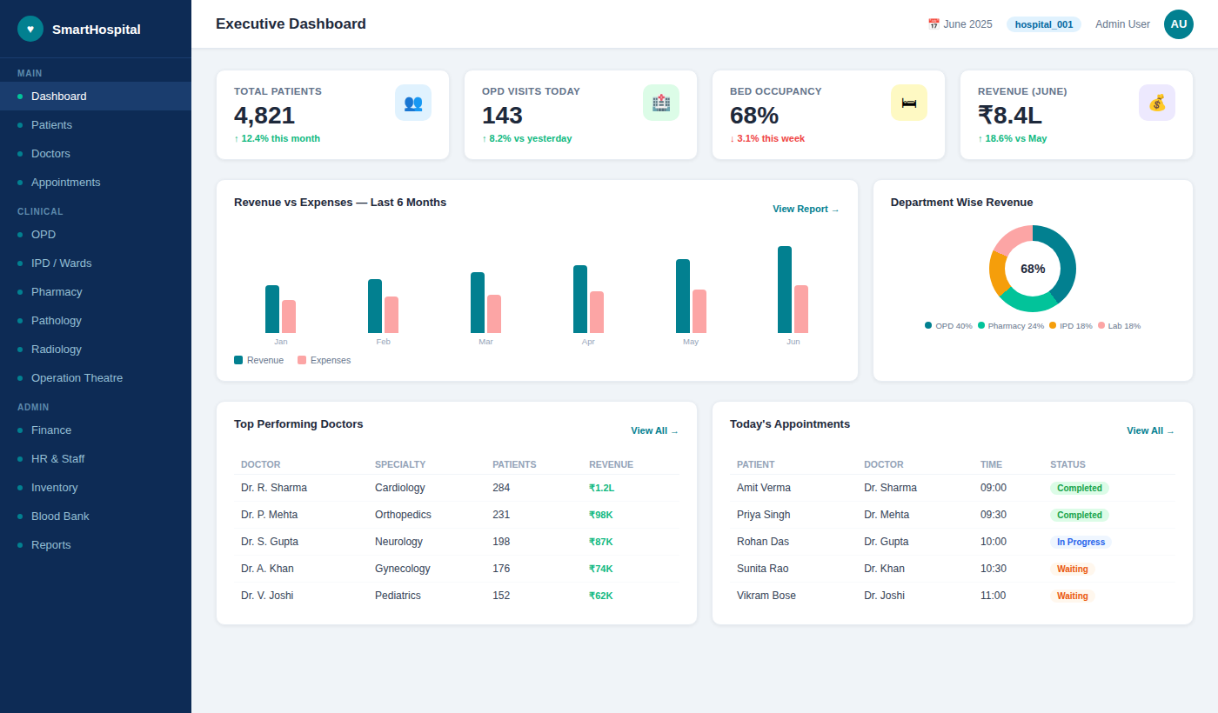
LIVE UI · 01 / 06
Executive Dashboard
The whole hospital at a glance — refreshed UI, same one-screen clarity.
Live KPI cards — patients, OPD, occupancy, revenue
Revenue vs expense, 6-month trend
Top doctors & today's appointments
Notes:
Now the live UI — newly revamped. Executive dashboard: KPI cards, revenue-vs-expense, department mix, top doctors, today's appointments — one glance, whole hospital.

Slide 16
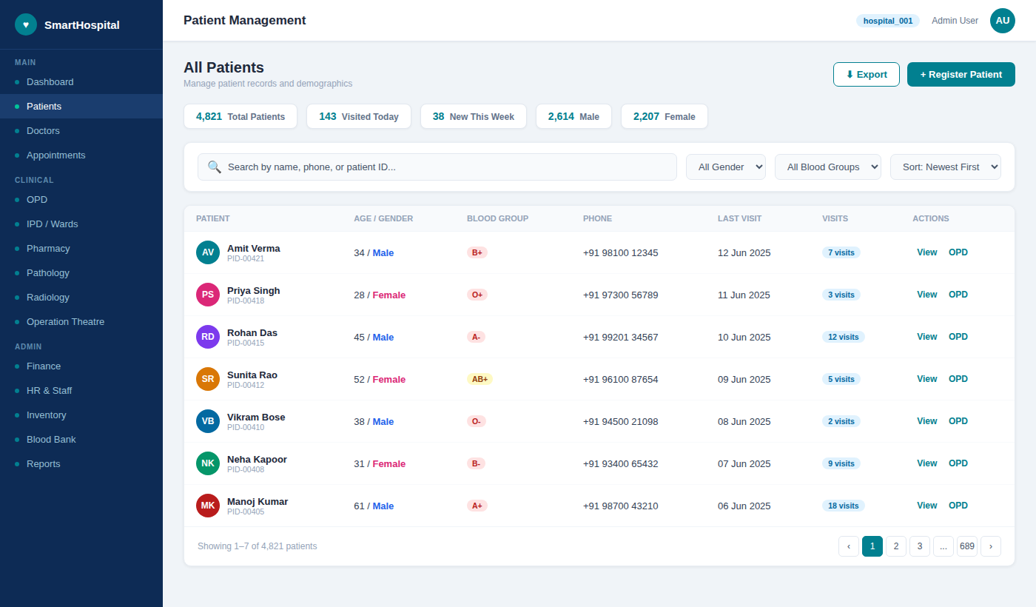
LIVE UI · 02 / 06
Patient Management
Find anyone in milliseconds; act in one click.
Full-text search by name, phone, or ID
Demographics, blood group & visit history
Quick OPD booking from the row
Notes:
Patient management screen. Full-text search bar, KPI strip, clean records table with blood group, visit counts, and quick OPD action — fast for a busy front desk.

Slide 17
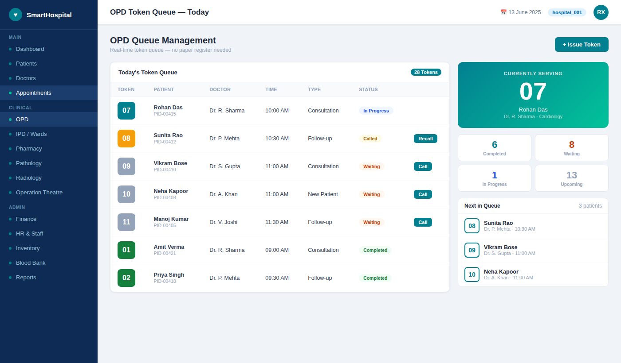
LIVE UI · 03 / 06
OPD Token Queue
Real-time token management — no paper register needed.
Live "currently serving" display
Call / recall & status per token
Waiting, in-progress & completed counts
Notes:
OPD token queue. Live serving panel, status per token, next-in-queue — the paper register is gone entirely.

Slide 18
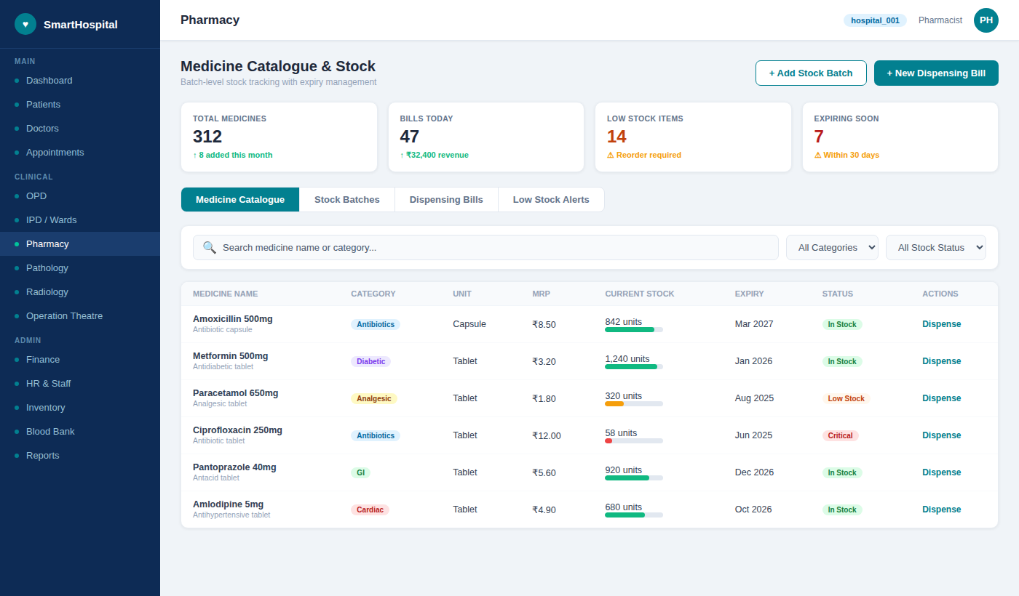
LIVE UI · 04 / 06
Pharmacy — Medicine & Stock
Never dispense what you don't have.
Batch-level stock with health bars
Expiry tracking & low-stock / critical alerts
One-click dispensing bill
Notes:
Pharmacy screen. Stock-health bars, expiry dates, low-stock and critical badges, dispense from the row. Inventory you can actually trust.

Slide 19
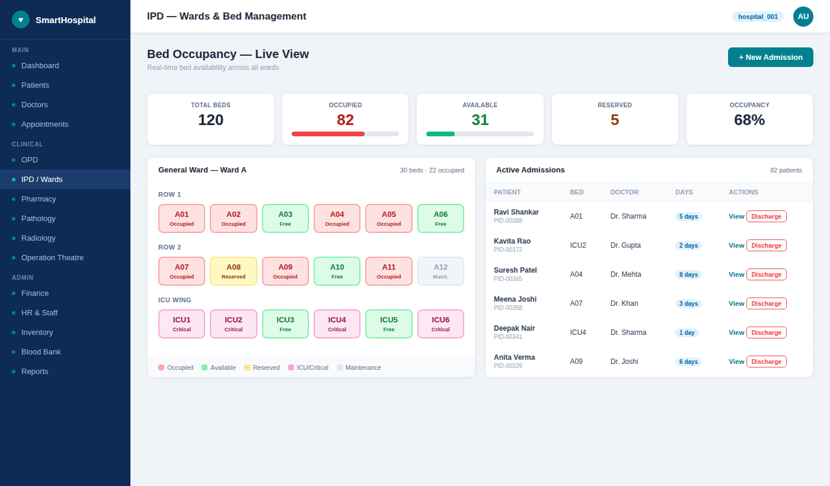
LIVE UI · 05 / 06
IPD — Bed Management
The whole floor, color-coded and live.
Visual bed map across all wards
Real-time occupancy & ICU tracking
Admission & discharge workflow
Notes:
IPD bed management. A visual bed map with live occupancy, ICU tracking, and admission/discharge — the floor at a glance.

Slide 20
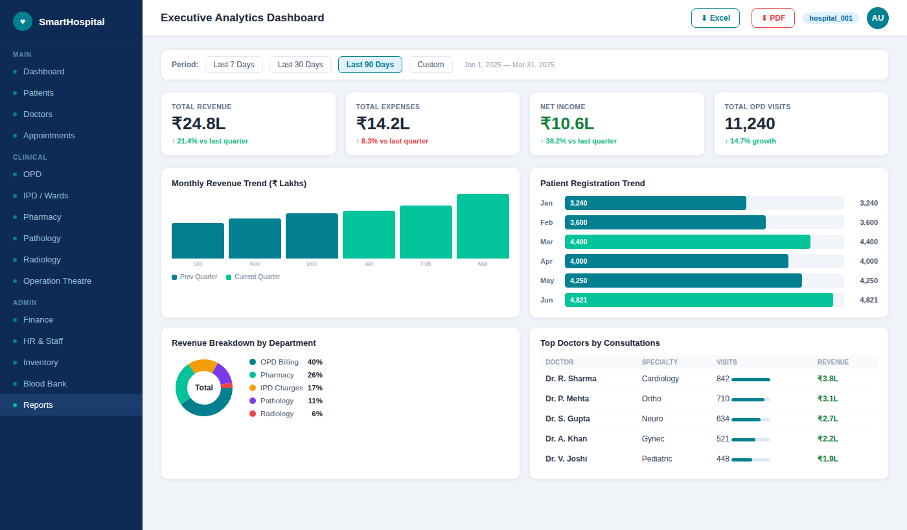
LIVE UI · 06 / 06
Analytics & Reporting
Eight dashboards, one export button.
Period filters & quarter-on-quarter KPIs
Revenue trend & department breakdown
One-click Excel & PDF export
Notes:
Analytics & reporting. Period filters, KPI deltas, revenue trend, department breakdown, top doctors — and Excel/PDF export, top right. End the showcase here.

Slide 21
♥
SmartHospital
NEXT STEP
Let's Transform Your Hospital Together
Live Demo
Pilot Deployment
Custom Proposal
Walk through any module together, on real data.
Run it on your own network — free, no commitment.
A tailored scope & timeline built for your clinic.
Notes:
Close strong and make it easy to say yes. Three paths: a live demo of any module, a free pilot on their own network, or a tailored proposal. Invite them to pick one today.

