Slide 1
🏥
SmartClinic
CONFIDENTIAL DEMO
The Front Desk to Discharge Platform
for Clinics & Polyclinics
One system for booking, check-in, consultation, pharmacy, diagnostics and billing — built specifically for how a clinic actually runs.
8
23
10
1 hr
Clinical & front-office modules
Flyway DB migrations
Role-based access profiles
Time to stand up a new tenant

Slide 2
THE STATUS QUO
Running a Clinic Still Means Fighting the Front Desk
!
!
!
Phone-Only Booking
Walk-in vs. Appointment Chaos
Paper OPD Registers
Every appointment is a phone call and a paper diary entry — no visibility, no reminders, easy to double-book.
Front desk can't tell who's booked and who's a walk-in — patients wait, staff argue, doctors lose time.
Visit notes, prescriptions and charges live in a register — no visit history, nothing searchable.
!
!
!
No Real-Time Stock Visibility
Zero Analytics
Shared Logins, No Audit Trail
Pharmacy finds out medicine ran out at the counter, not before — lost sales, frustrated patients.
Owners find out revenue and footfall trends a month late, from a tally register, if at all.
One shared “reception” login for everyone — no way to know who booked, edited, or cancelled what.
SmartClinic
02

Slide 3
THE APPROACH
Built for the Clinic Front Desk, Not Bolted On
A modern platform where booking, check-in, and the OPD queue are one connected flow — not three disconnected registers.
✓
✓
✓
One Patient Journey
Race-Condition Safe Check-In
Purpose-Built for Clinics
Appointment → check-in → OPD visit → prescription → pharmacy → bill, as a single connected record per patient.
Pessimistic row locks + a unique index stop double check-ins even when two front-desk staff click at once.
Every module — patients, OPD, pharmacy, pathology, HR — designed around a single clinic's daily front-desk workflow, not squeezed in.
✓
✓
✓
Security-First
Built-in Analytics
Fast to Deploy
JWT + RBAC, schema-per-tenant isolation, Flyway-only migrations — enterprise-grade discipline from day one.
Executive dashboard plus 8 module reports, with one-click Excel & PDF export — no spreadsheet reconciliation.
DB setup, Flyway migrations, seed data — a new clinic tenant is live in under an hour.
SmartClinic
03

Slide 4
UNDER THE HOOD
Architecture for the Real World
React 19 + TypeScript
Ant Design 5 · TanStack Query · Zustand · React Hook Form + Zod
Frontend
↓
Spring Boot 3.3 API
JWT Auth · Tenant Filter · 17 Domain Modules · Prometheus Metrics
Backend
↓
PostgreSQL 16
Schema-per-Tenant · Flyway Migrations · Full-Text Search
Database
JWT + RBAC
Bucket4j Rate Limiting
Micrometer + Prometheus
Flyway-Only DDL
SmartClinic
04

Slide 5
THE PLATFORM
One Platform, Every Front-Desk-to-Billing Module
Everything a clinic or polyclinic needs to run its front desk, clinical visits, pharmacy and back office — in one login.
FRONT DESK & CLINICAL
PHARMACY, LABS & STAFF
REPORTS & ANALYTICS
Dashboard & KPIs
Pharmacy & Billing
Executive Dashboard
Patient Management
Pathology + Home Collections
Patient & Appointment Analytics
Front Office & Appointments
HR & Attendance
Pharmacy & Lab Analytics
OPD Visits & Prescriptions
Excel / PDF Export
1 Login
20s
FEFO
Every module, every role, one account
OPD queue auto-refresh — no manual reload
Pharmacy stock deducted oldest-batch-first
SmartClinic
05

Slide 6
THE CORE WORKFLOW
Every Way In, One Connected Visit
Whether the patient called ahead or walked straight in, both routes land in the same OPD queue and the same visit record.
PATH A · CALLED AHEAD FOR AN APPOINTMENT
Patient Calls
Appointment Booked
Patient Checks In
Check-In Confirmed
Front desk answers — no portal needed
Doctor, department, date & slot picked
One click at the front desk, same day
Visit created atomically — race-condition safe
→
Consult, Prescribe, Bill
SCHEDULED
SCHEDULED
CHECKED_IN
CHECKED_IN
Moved to OPD Queue
→
Diagnosis, prescription and charges captured; visit marked COMPLETED
PATH B · WALKS IN WITHOUT AN APPOINTMENT
Token issued — both paths land in the same live queue, tagged by source
Patient Walks In
Walk-in Visit Registered
COMPLETED
No appointment needed — front desk registers the visit on the spot
OPD visit created directly, doctor assigned — no check-in required
→
WALK_IN
WALK_IN
IN_PROGRESS
Under the hood: every visit is tagged by source — Appointment or Walk-in — so the queue always shows how the patient arrived. A pessimistic row lock + a partial unique index on opd_visits.appointment_id stop duplicate check-ins even if two staff act on the same patient at once.
SmartClinic
06

Slide 7
MODULE 01 · FRONT OF HOUSE
Front Office, Appointments & OPD
Appointments
OPD & the Live Queue
Book by date, time slot, doctor, department & type — auto APT-YYYY-NNNNN numbering
Numbered tokens per department per day — WAITING → IN_PROGRESS → COMPLETED / SKIPPED
Status flow: SCHEDULED → CONFIRMED → CHECKED_IN → COMPLETED, plus CANCELLED / NO_SHOW
Today's Queue auto-refreshes every 20s — no manual reload for the doctor
Closed appointments (completed / cancelled / no-show) can't be edited
Visit source badge distinguishes Appointment vs. Walk-in at a glance
Filter by date, patient, or doctor for the front desk's daily view
Full visit history, prescriptions and charges per patient, searchable instantly
SmartClinic
07

Slide 8
MODULE 02 · PHARMACY & DIAGNOSTICS
Pharmacy, Pathology & Home Collections
Pharmacy
Pathology & Home Collections
Medicine catalogue with categories, HSN & GST, and reorder alerts
Configurable test catalogue with reference ranges by category
Batch-level stock with expiry tracking — FEFO deduction on every dispense
Sample collection workflow with status tracking and turnaround time
One-click dispensing bill linked to the patient's OPD visit
Home Collections: schedule a technician visit for clinic-mode tenants
Analytics: top sellers, dispensing revenue trend, stock movement
Consolidated Visit Bills combine consultation + tests + medicines
SmartClinic
08

Slide 9
MODULE 03 · BACK OFFICE & INTELLIGENCE
HR, Attendance & Reports & Analytics
HR & Attendance
Reports & Analytics
Departments, designations & employee master with photos
Executive
Patient
Daily attendance — Present / Absent / Half Day / On Leave
Appointment
Pharmacy
Leave types and an approval workflow (Pending → Approved/Rejected)
Laboratory
Employee directory, searchable by name, department or designation
Configurable date ranges — 7 / 30 / 90 days or custom, on every dashboard
One-click export: multi-sheet Excel with KPI summary and trend tables
Branded PDF export via iText — authenticated, sent through the API client
SmartClinic
09

Slide 10
TRUST & COMPLIANCE
Security & Multi-Tenancy
JWT Stateless Auth
Granular RBAC
15-minute access tokens, 7-day refresh, auto-refresh via Axios interceptor. Zero session state on the server.
10 roles × 40+ permissions. Every API method guarded with @PreAuthorize. Roles and permissions embedded in the JWT.
Schema-per-Tenant
Flyway-Only DDL
Each clinic gets its own PostgreSQL schema. Cross-tenant access is architecturally impossible at the JDBC level.
Hibernate never touches the schema. Every change is a versioned, peer-reviewed migration — full audit trail.
SmartClinic
10

Slide 11
WHY SWITCH
SmartClinic vs. the Paper Register
SmartClinic
Manual / Paper-Based
Booking
Online-ready, conflict-checked slots
Phone call, paper diary, double-bookings
Check-In
One click, race-condition safe, instant OPD queue
Manual register lookup, easy to miss or duplicate
Visit History
Full searchable history per patient, every visit
Scattered across paper files, often lost
Pharmacy Stock
Real-time batch tracking, FEFO, low-stock alerts
Found out at the counter, after the sale is lost
Analytics
Live dashboards + one-click Excel/PDF export
Manual tally, weeks behind, error-prone
Access Control
10 roles, per-action permissions, full audit trail
One shared login, no accountability
SmartClinic
11

Slide 12
THE STACK
Built on Enterprise-Grade Technology
Backend
Frontend
Data & Ops
Java 21 (LTS)
React 19 + TypeScript
PostgreSQL 16 with FTS
Spring Boot 3.3 + Security 6
Ant Design 5
Flyway 10 (23 migrations)
jjwt 0.12 (HMAC-SHA256)
TanStack Query + RHF + Zod
Schema-per-tenant
Bucket4j rate limiting
ApexCharts 5
Docker + Docker Compose
Apache POI + iText 7
Zustand 4 state mgmt
Nginx reverse proxy
Micrometer + Prometheus
Axios with JWT auto-refresh
SpringDoc OpenAPI (Swagger)
SmartClinic
12

Slide 13
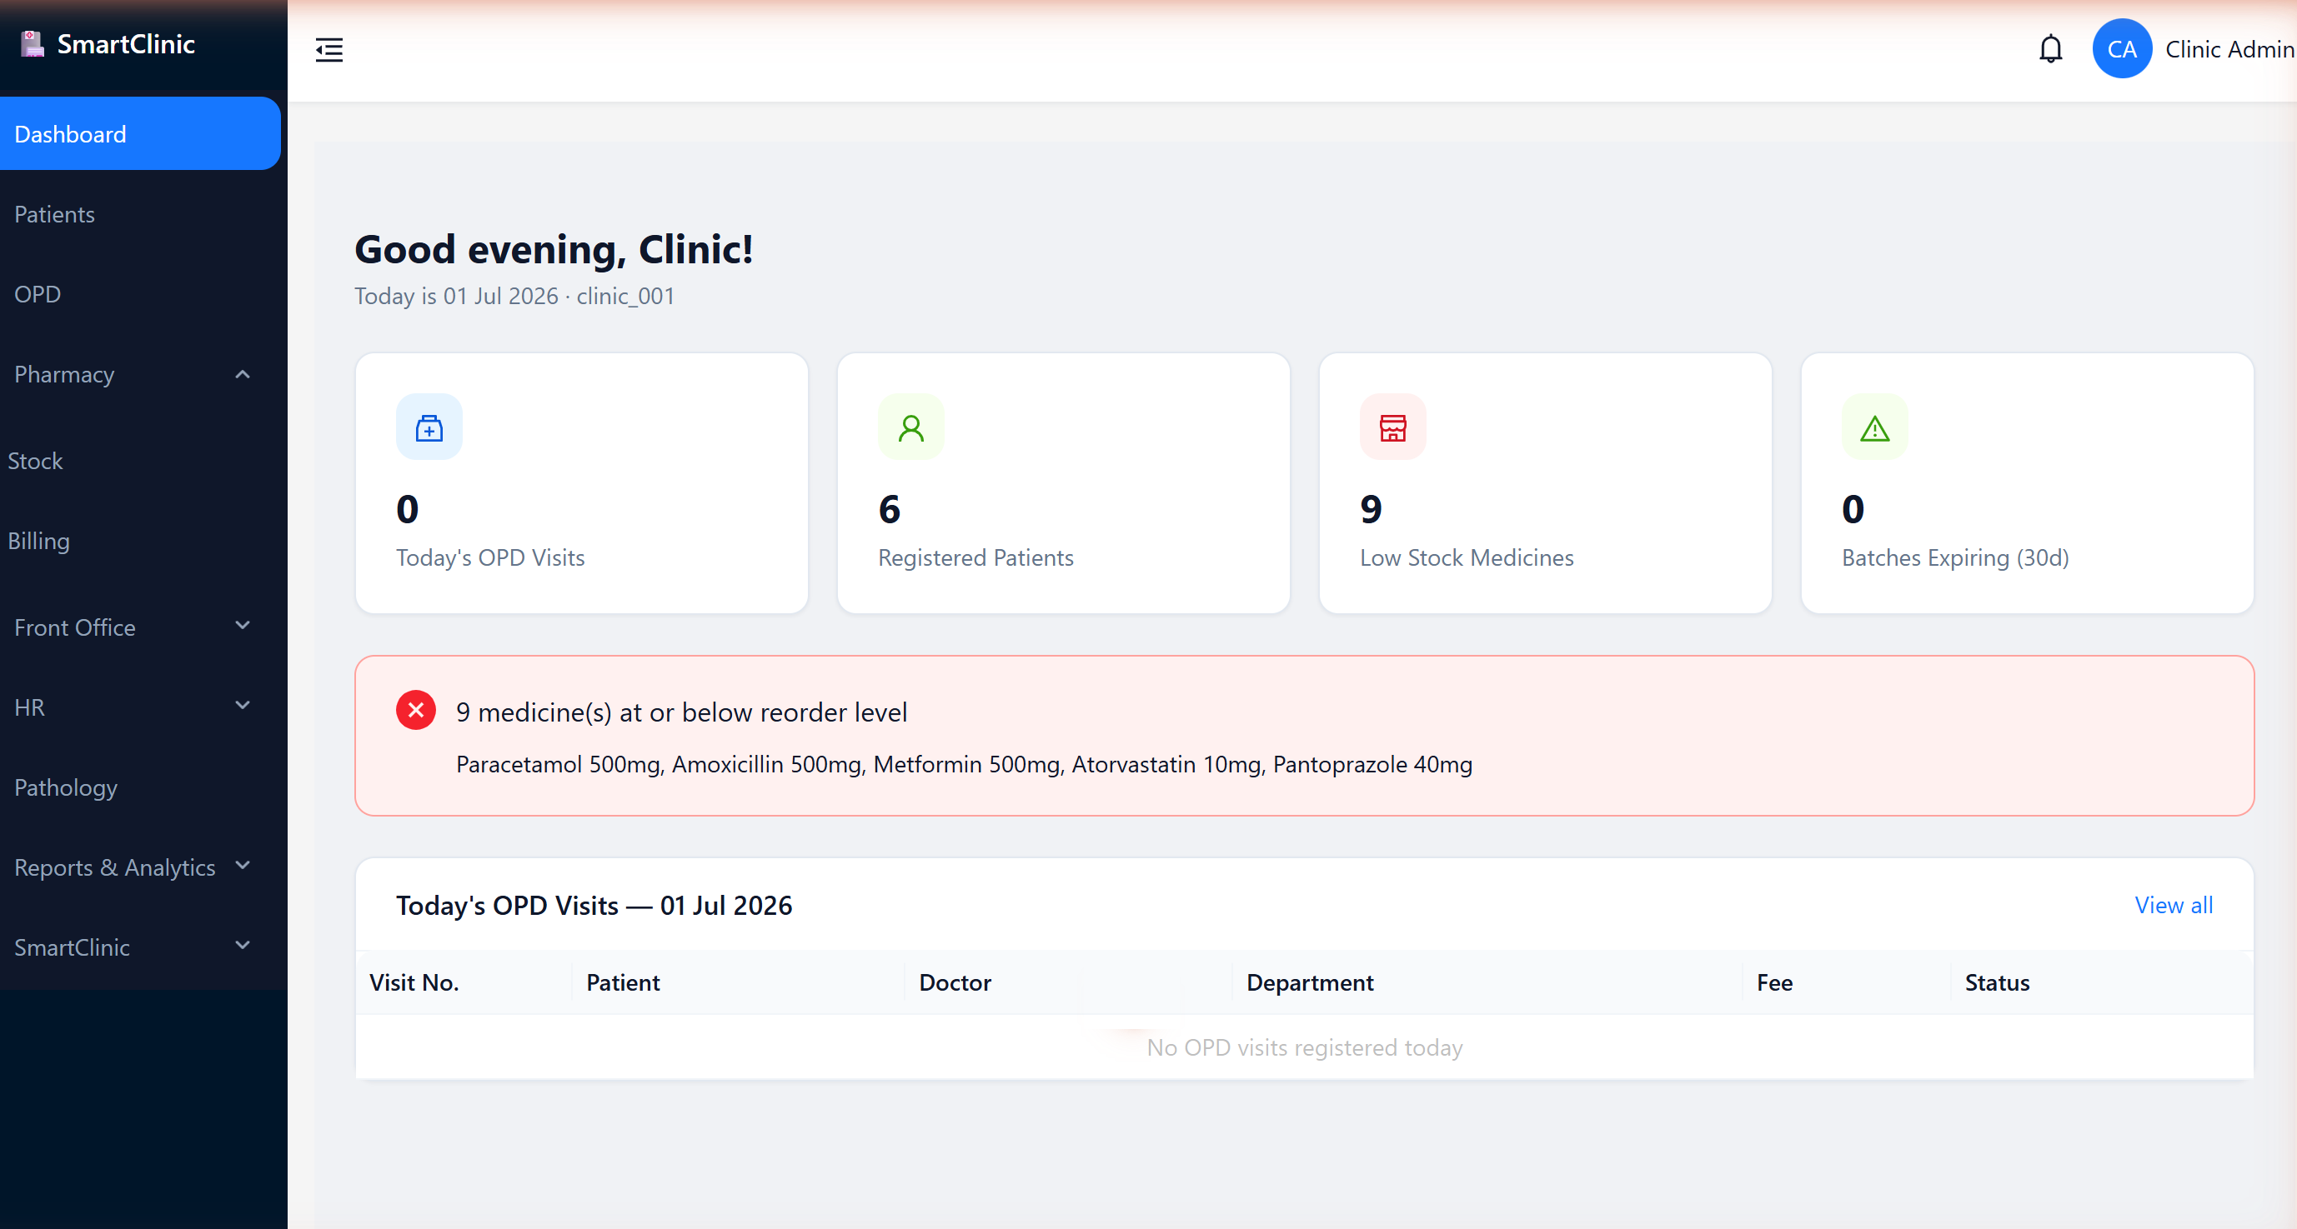
LIVE UI · 01 / 06
Executive Dashboard
The whole clinic at a glance, from login.
Today's OPD visits, registered patients, low-stock medicines
Live alert banner for medicines at or below reorder level
Today's OPD visit table, refreshed automatically
SmartClinic
13

Slide 14
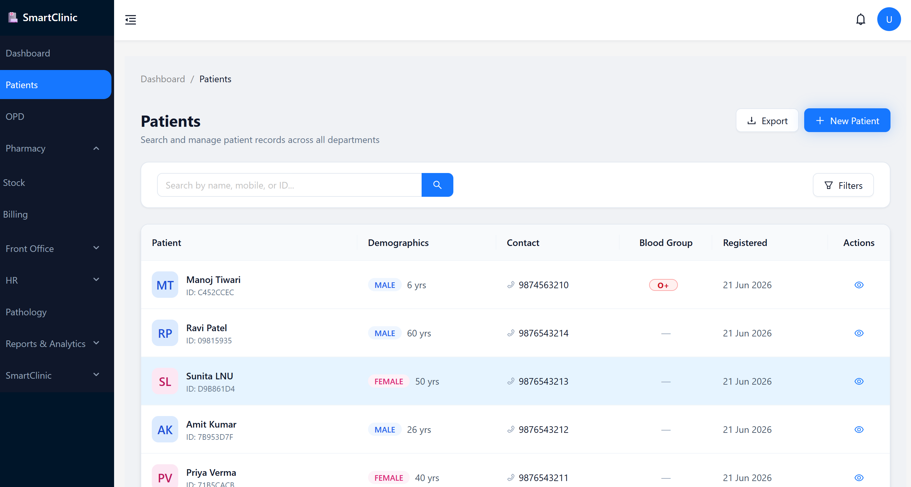
LIVE UI · 02 / 06
Patient Management
Find anyone in milliseconds; act in one click.
Full-text search by name, mobile, or patient ID
Demographics, blood group, contact & registration date
Quick actions: view profile, book appointment, start a visit
SmartClinic
14

Slide 15
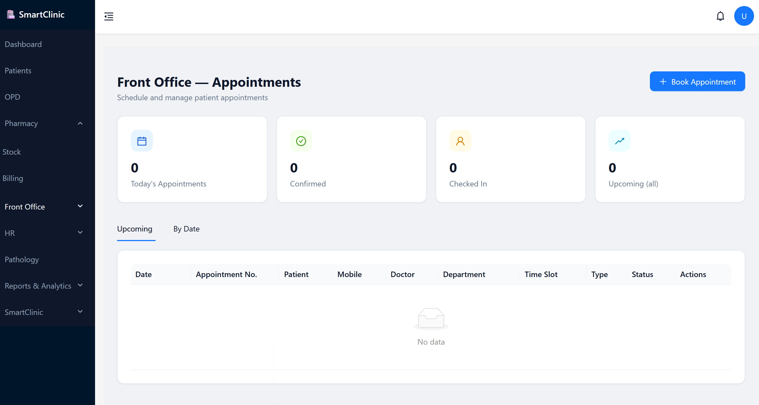
LIVE UI · 03 / 06
Front Office — Appointments
The first step of the flow: book, confirm, check in.
Today's appointments, confirmed count and check-ins at a glance
One-click “Book Appointment” with doctor, department & time slot
Status-tracked list — exactly the step 1–2 of the patient flow
SmartClinic
15

Slide 16
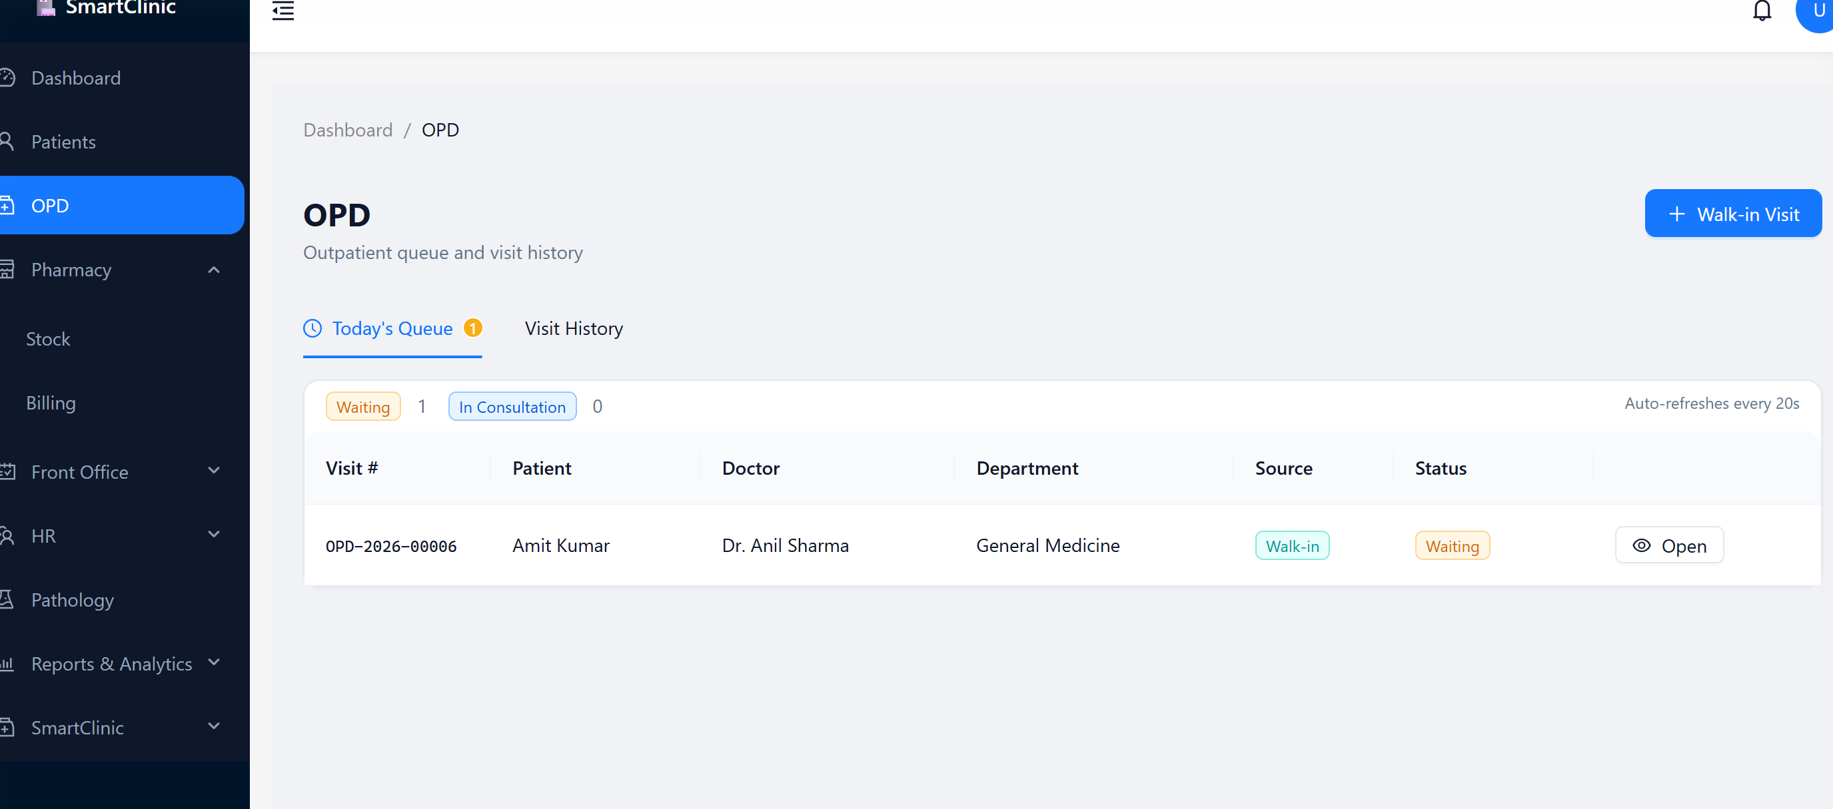
LIVE UI · 04 / 06
OPD — Live Queue
Where a checked-in patient lands, automatically.
Waiting / In Consultation counts update in real time
Every visit tagged by source — Appointment or Walk-in
This is exactly steps 4–5 of the patient flow, live
SmartClinic
16

Slide 17
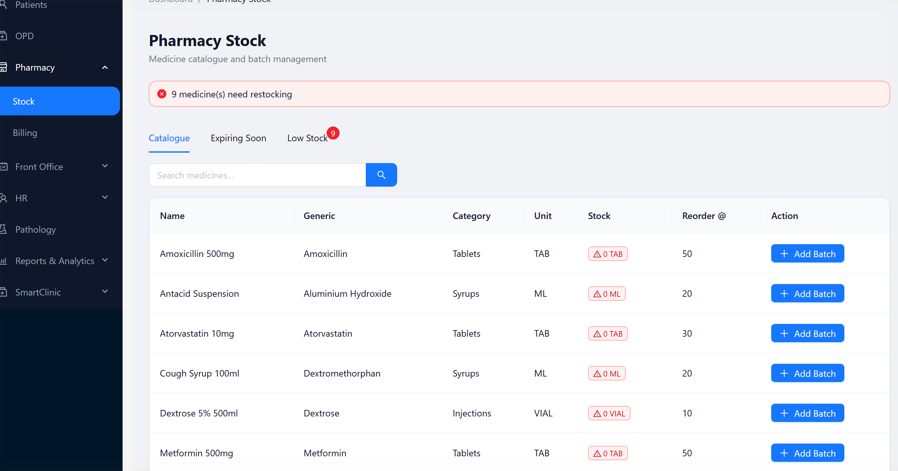
LIVE UI · 05 / 06
Pharmacy — Stock & Catalogue
Never dispense what you don't have.
Medicine catalogue with generic names and categories
Automatic “needs restocking” alerts, counted live
Catalogue, Expiring Soon and Low Stock in one tabbed view
SmartClinic
17

Slide 18
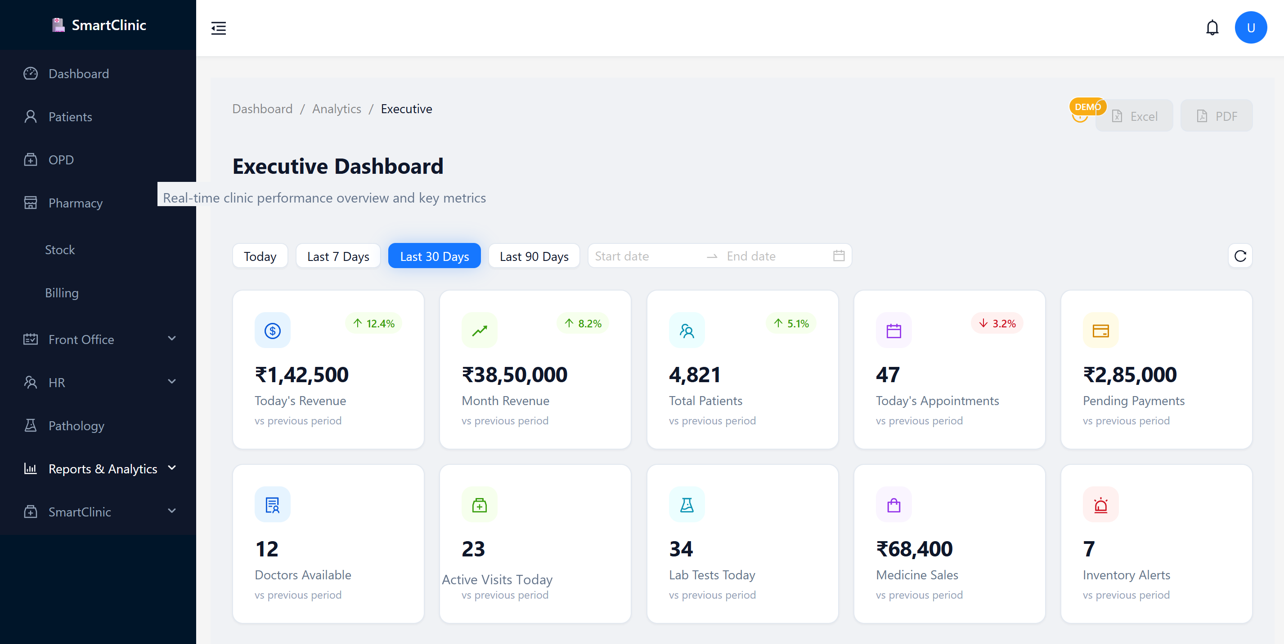
LIVE UI · 06 / 06
Executive Analytics
Revenue and operations, updated in real time.
Today's revenue, month revenue, doctors available, active visits
Quick period filters — Today / 7 / 30 / 90 days
One-click Excel & PDF export for owners and investors
SmartClinic
18

Slide 19
🏥
SmartClinic
NEXT STEP
Let's Put Your Front Desk on SmartClinic
Same platform, your data, your clinic's workflow — walked through live.
Live Demo
Pilot Deployment
Custom Proposal
Walk through booking, check-in and the OPD queue together, on real data.
Run it on your own clinic for a trial period — free, no commitment.
A tailored scope, timeline and pricing built for your clinic size.

